Slide 1
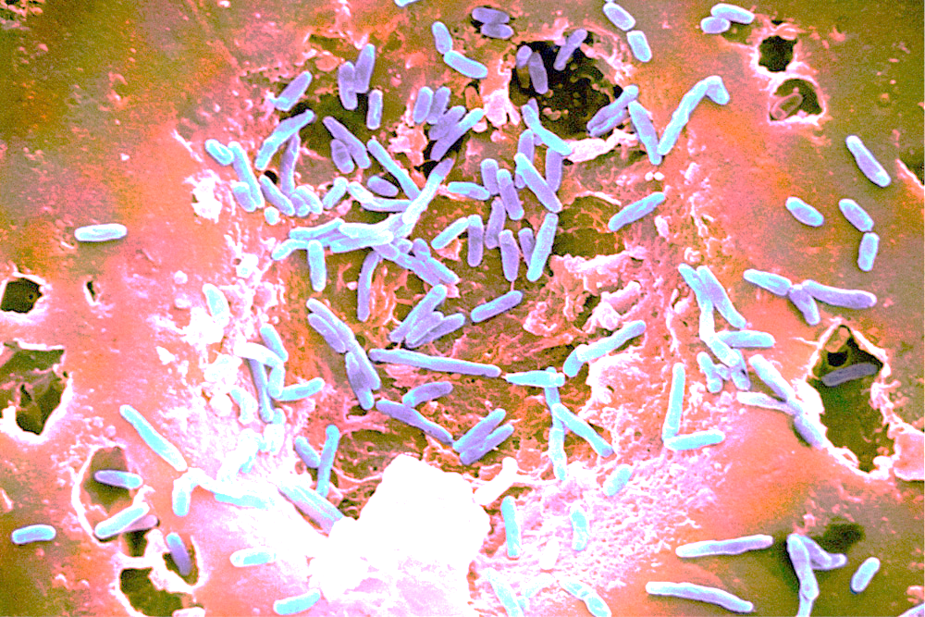
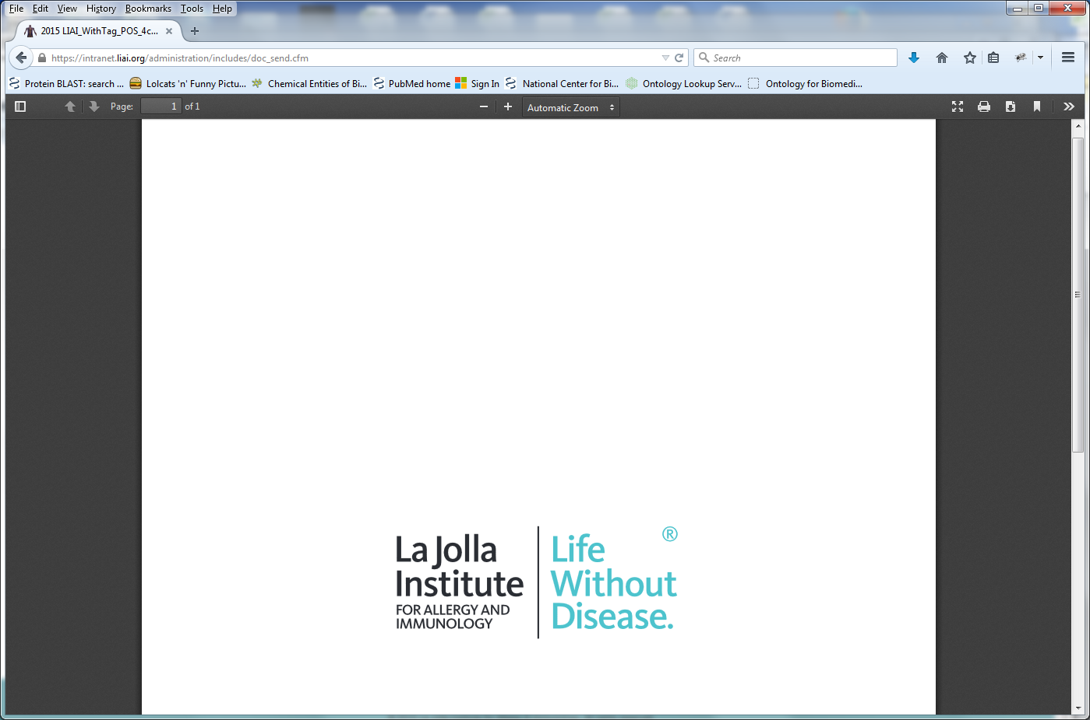
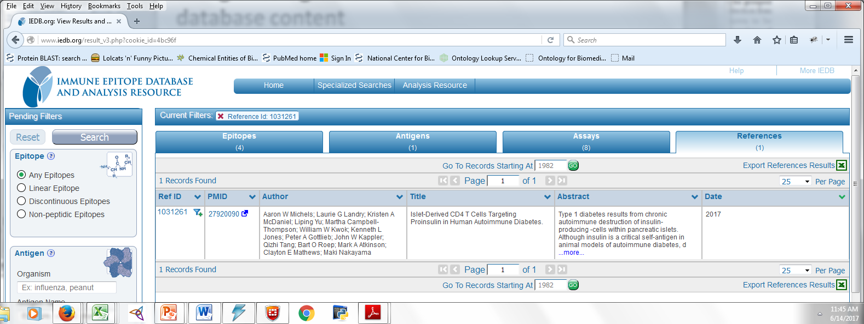
The Microbiome and Immunogenicity
Randi Vita, M.D.
Immune Epitope Database and Analysis Project La Jolla Institute for Allergy & Immunology La Jolla, CA

Slide 2
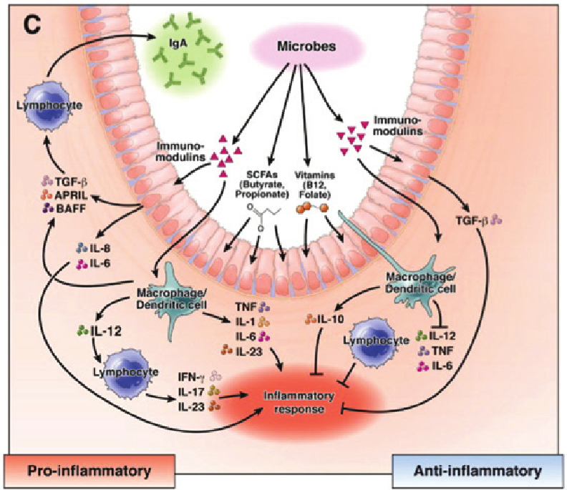
The microbiome exerts a profound influence on immune function
Bacteria secrete soluble factors and metabolites
These bioactive compounds affect the function of intestinal epithelium and mucosal immune cells, resulting in production of cytokines and related factors
(Adapted from Preidis and Versalovic [2009].)

Slide 3
Antigen Presenting Cells (APC) process allergens, self, pathogen, and microbiome proteins to present peptides to T cells via MHC molecules
bacterium
T cell
virus
APC

Slide 4
Peptides derived from microbiome may be homologous to pathogen or self derived peptides
Microbiome
bacterium

Slide 5
What is an epitope?
The portion of a pathogen, allergen, or autoantigen that the immune system recognizes is the epitope
T cells bind to epitopes to trigger an immune response
T cells recognize epitopes (typically peptides) presented by MHC molecules
APC
T cell
IMMUNE RESPONSE!

Slide 6
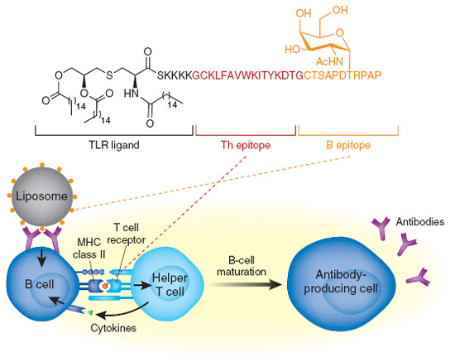
Why do epitopes matter?
Vaccine development
Allergy immunotherapy
Immunogenicity
Transplantation

Slide 7
Immunomodulatory Effects of Micobiome
Microbiome antigens, like any other antigen (self or pathogen), are processed by host APCs
Microbiome Ag processing will generate MHC presented peptides
These peptides are not made in the thymus (no central tolerance) = potential non-self epitopes
Yet, under normal conditions the microbiome epitopes are tolerated = peripheral tolerance

Slide 8
Does similarity to self or to the microbiome affect the immune response?
Similar to self = tolerance?
Similar to pathogen = higher response?
Does similarity matter?

Slide 9
Approach
Obtain T cell epitope recognition data from the IEDB
Quantify immunogenicity of epitopes based on frequency of recognition in human population
Determine of sequence conservation of epitopes in human proteome / human microbiome correlates with immunogenicity

Slide 10
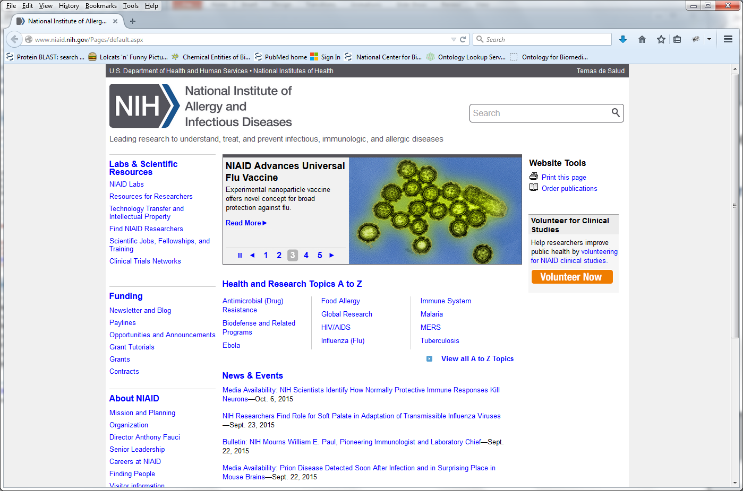
The Immune Epitope Database
Free online resource of experimentally-derived epitope information
IEDB has >99% of all published epitope data
Allergy, Infectious diseases, Autoimmune diseases, Transplant/alloantigens
New data is added every week
19,000 references
>1.5 million experimental assays

Slide 11
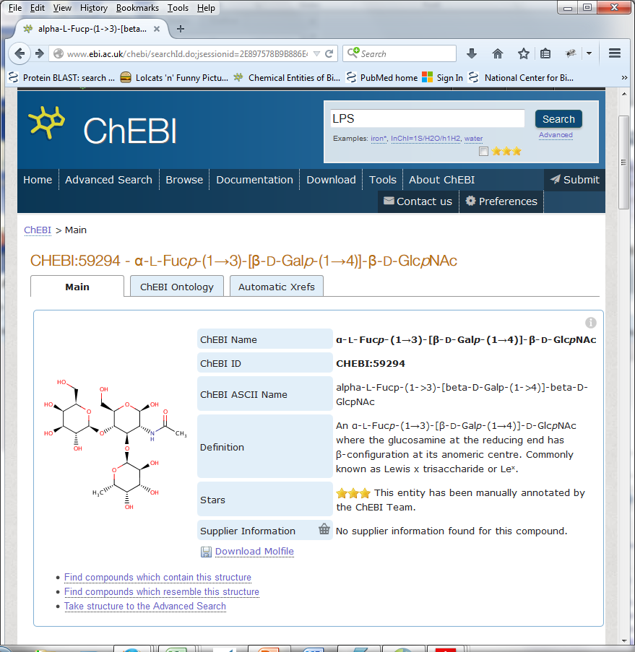
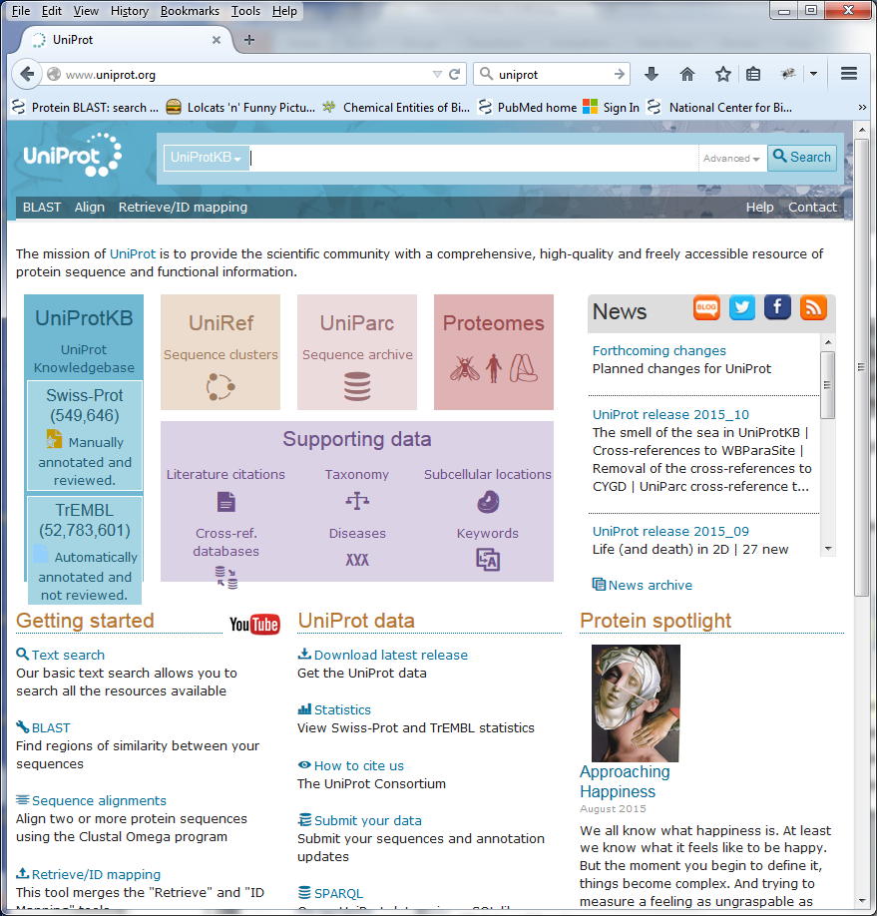
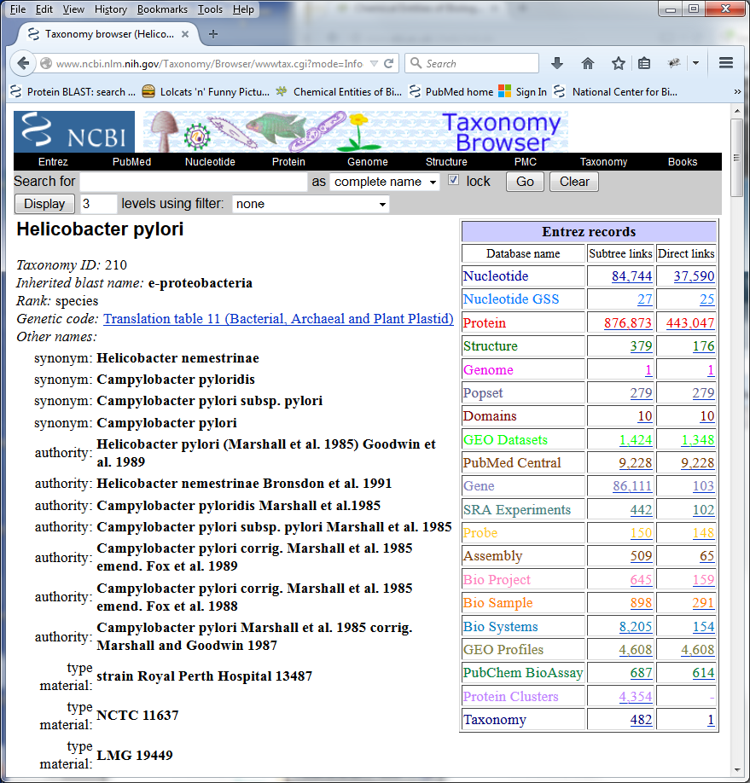

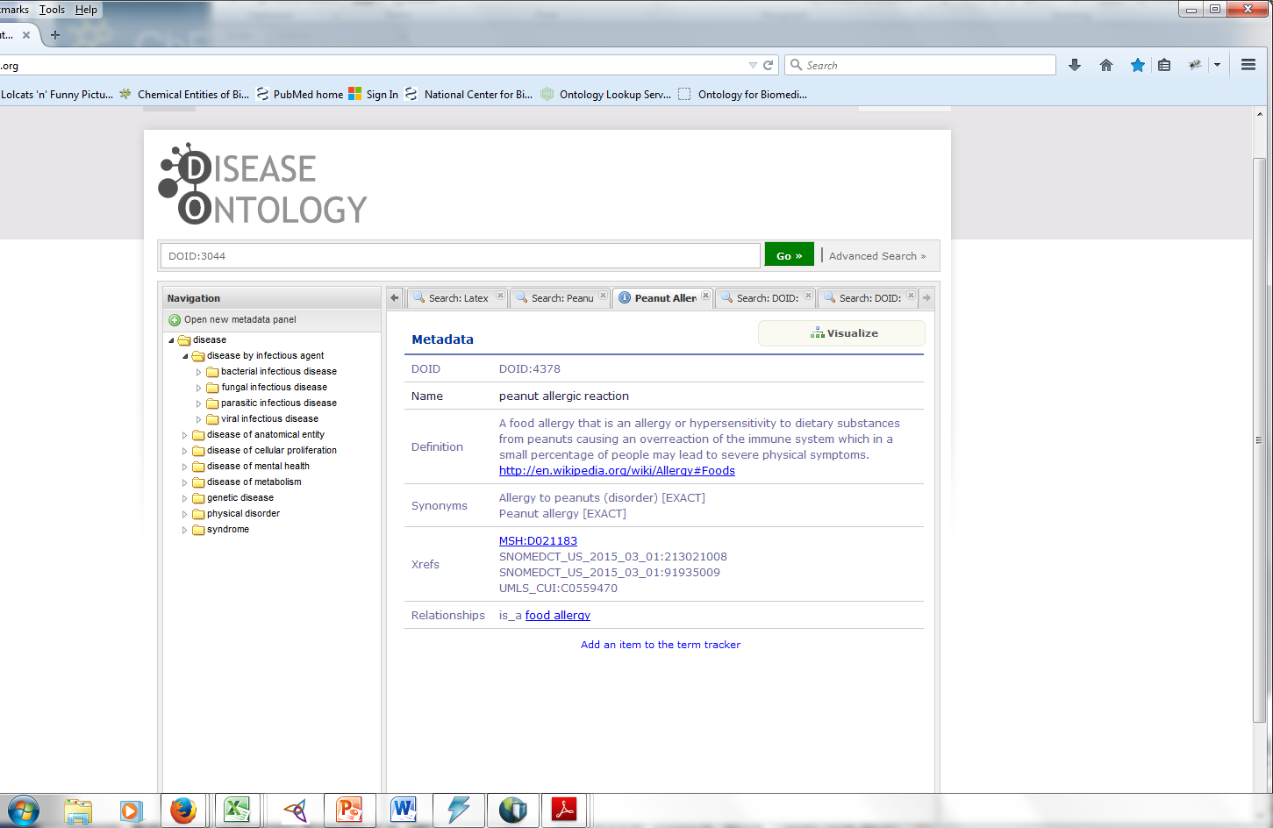
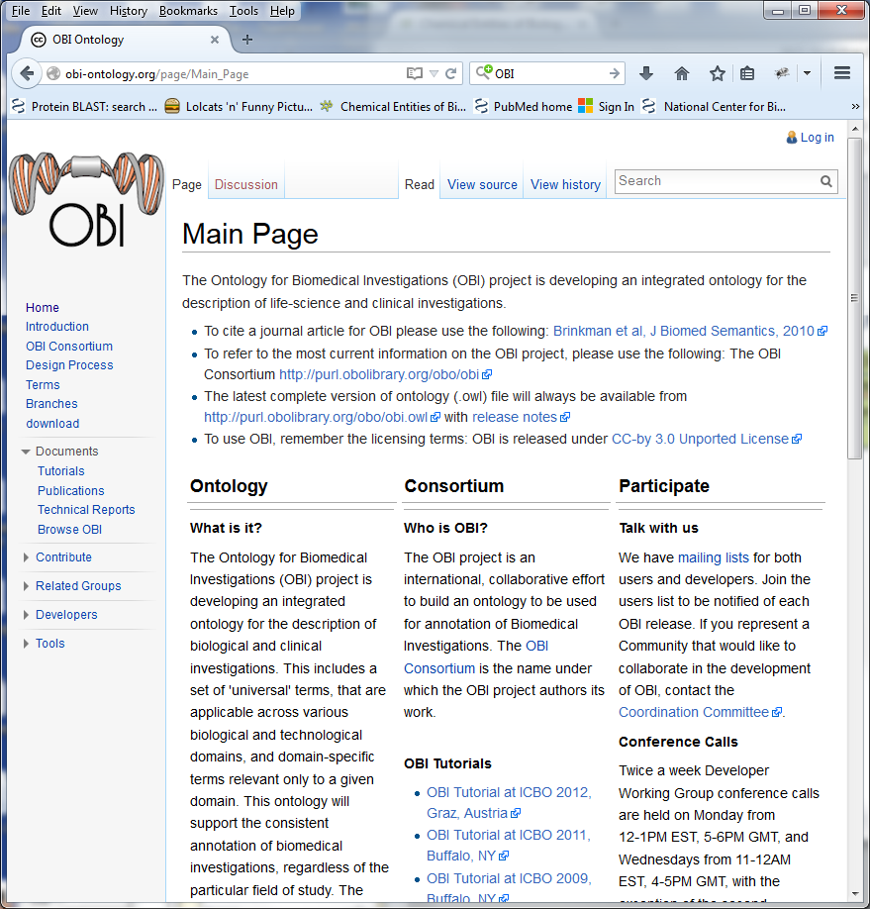
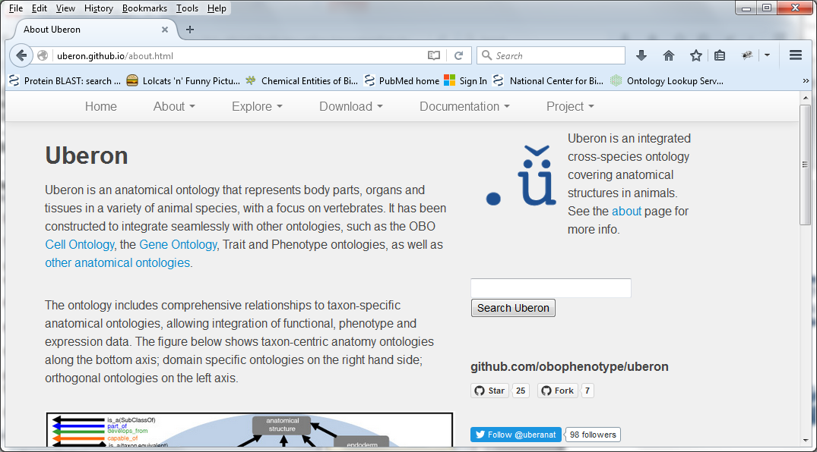

IEDB driven by external resources and ontologies (OBO)
Epitope
Structure
Source Molecule
Organism source
Immunization Process(es)
Host
Immunogen
Disease
Assay
Assay Type
T cells
MHC restriction
MRO

Slide 12
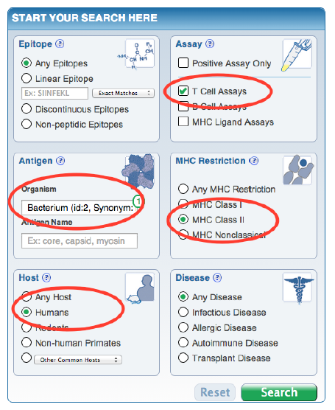
Obtaining Epitope Data from IEDB

Slide 13
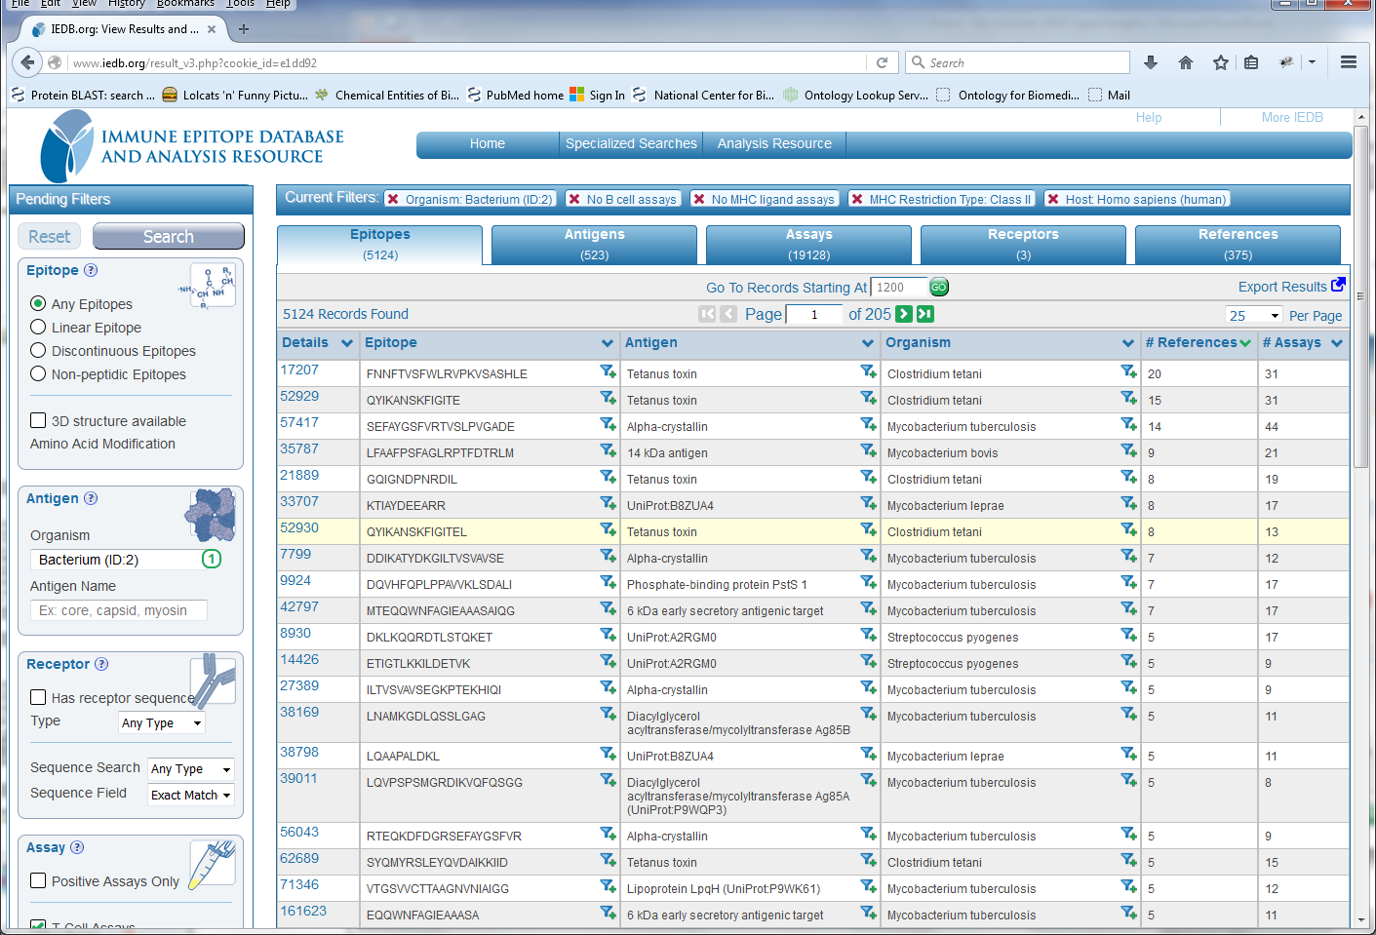
Human Bacterial Data in The IEDB

Slide 14
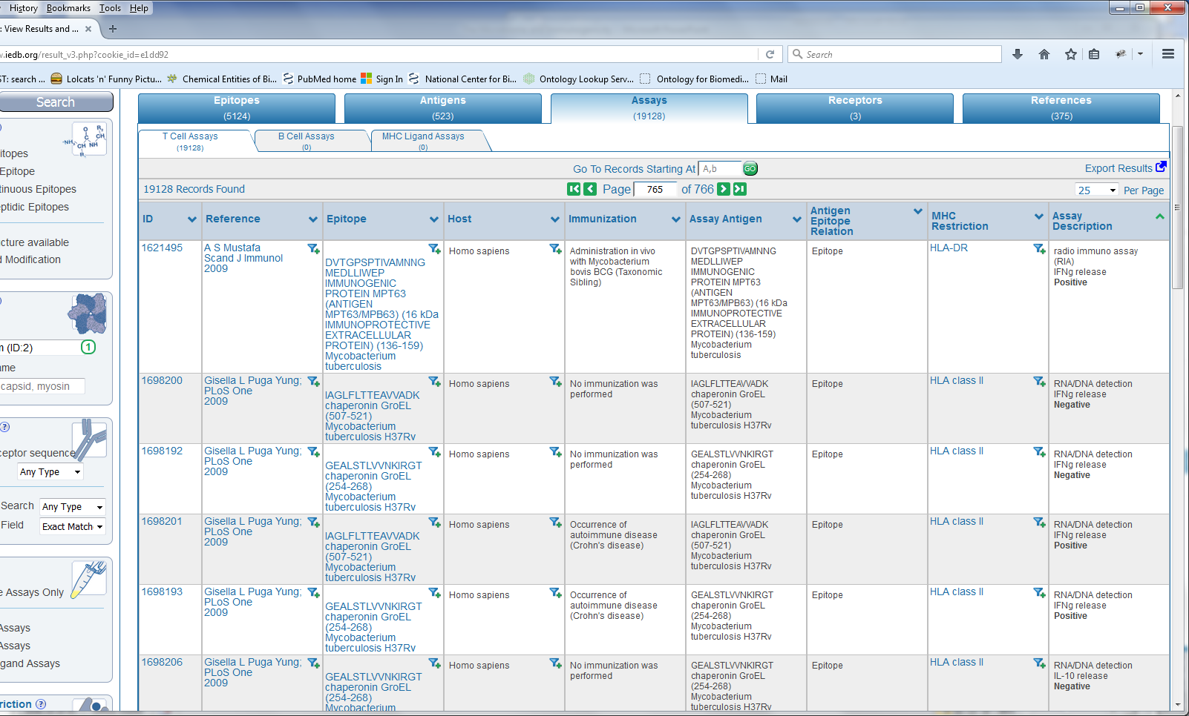
Assay Data in The IEDB

Slide 15
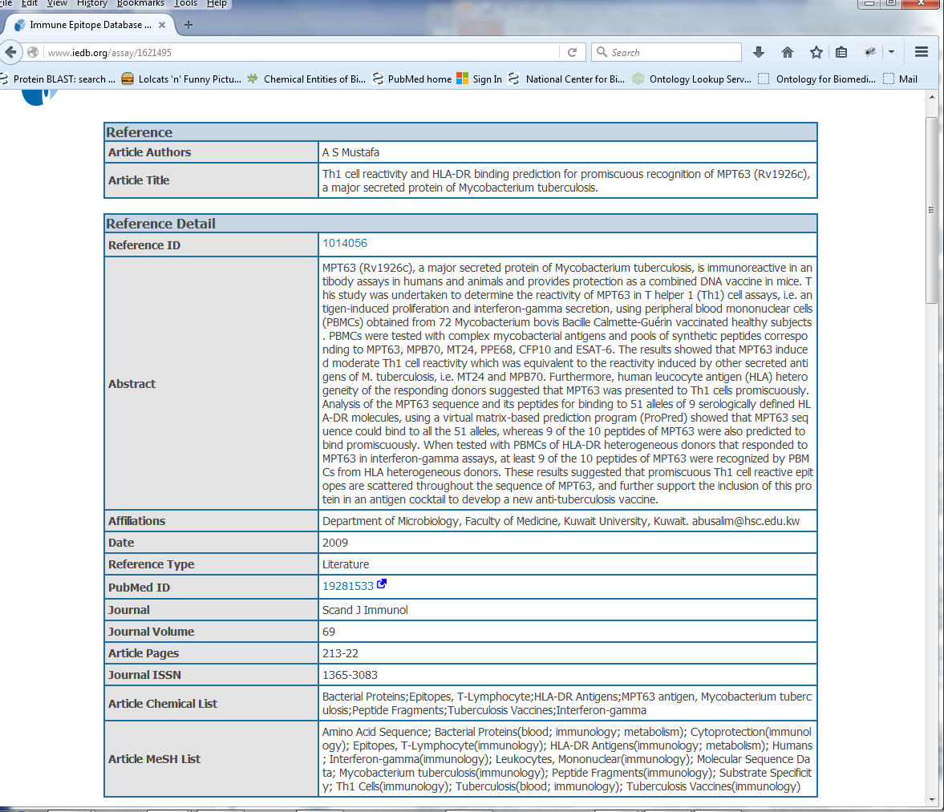

Slide 16
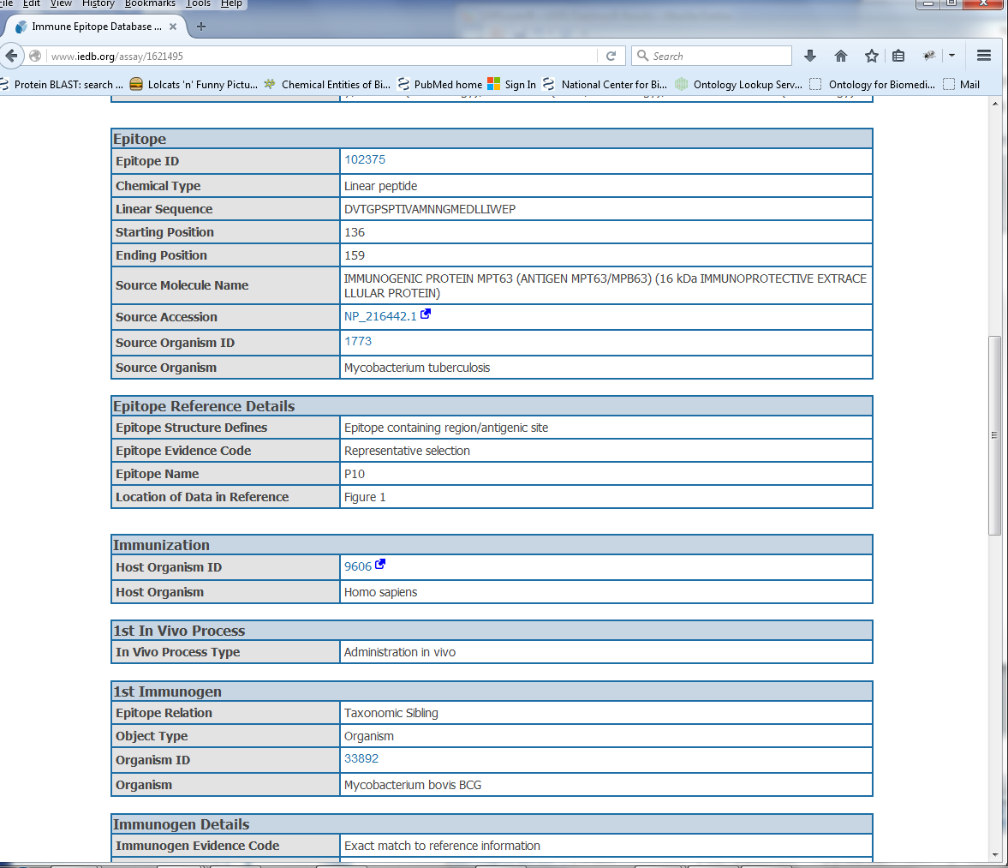

Slide 17
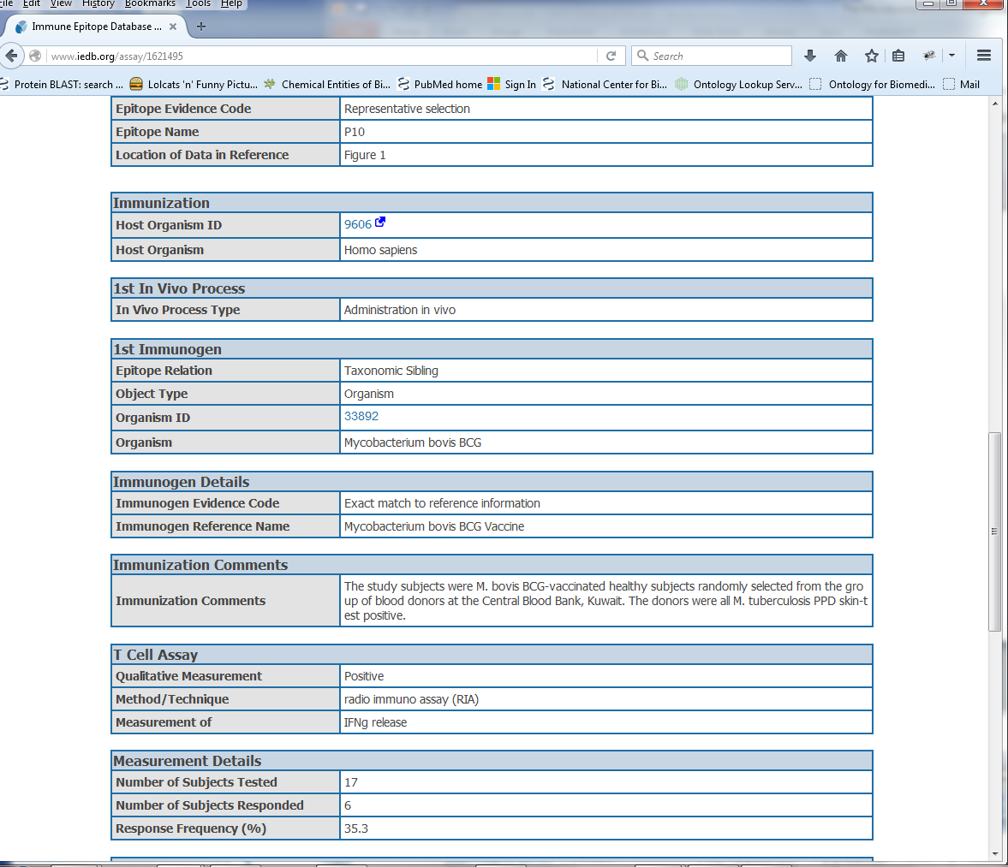

Slide 18
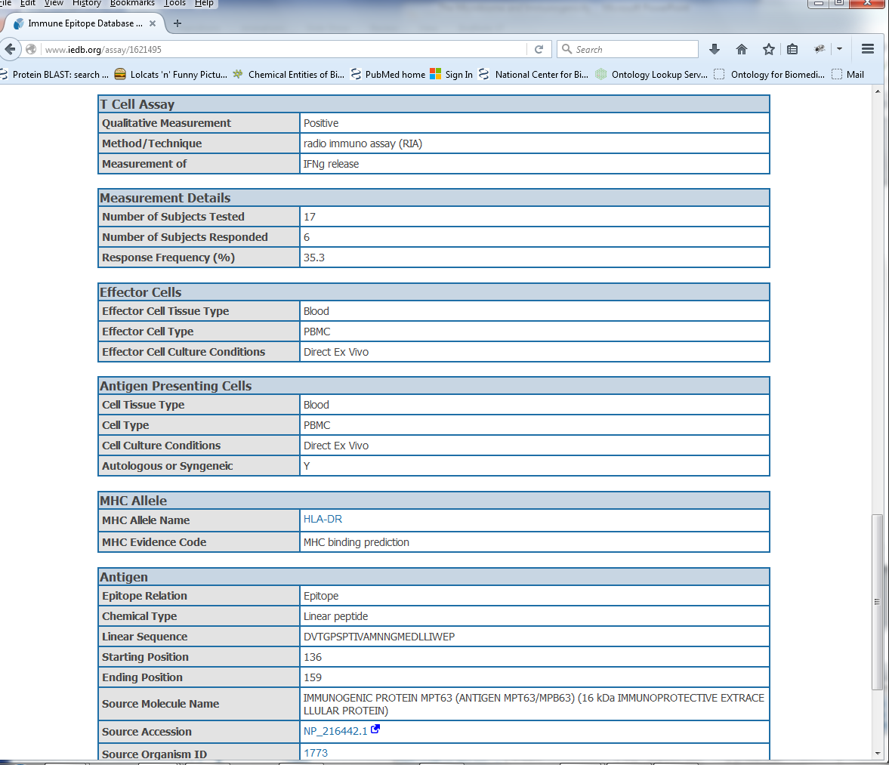

Slide 19
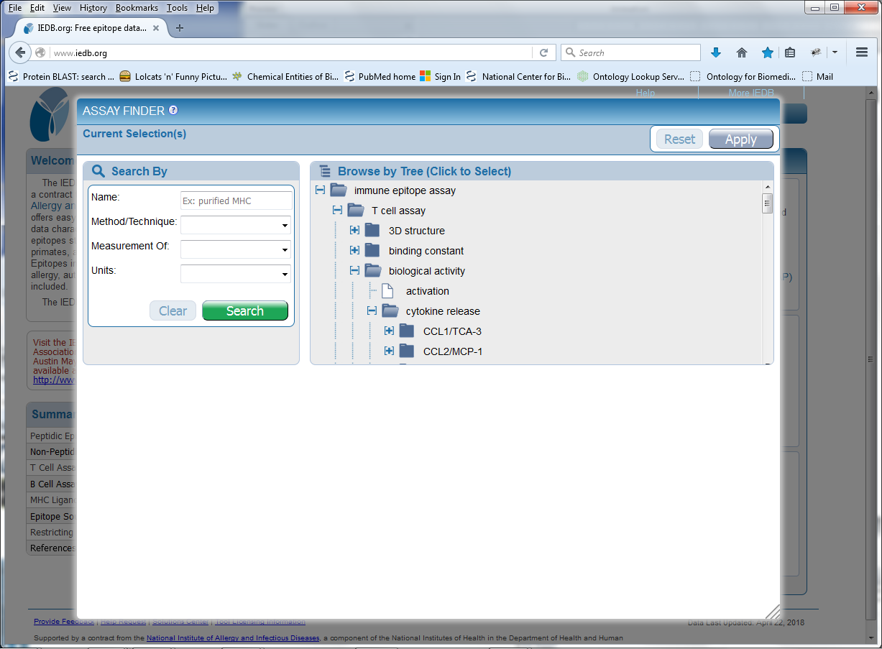
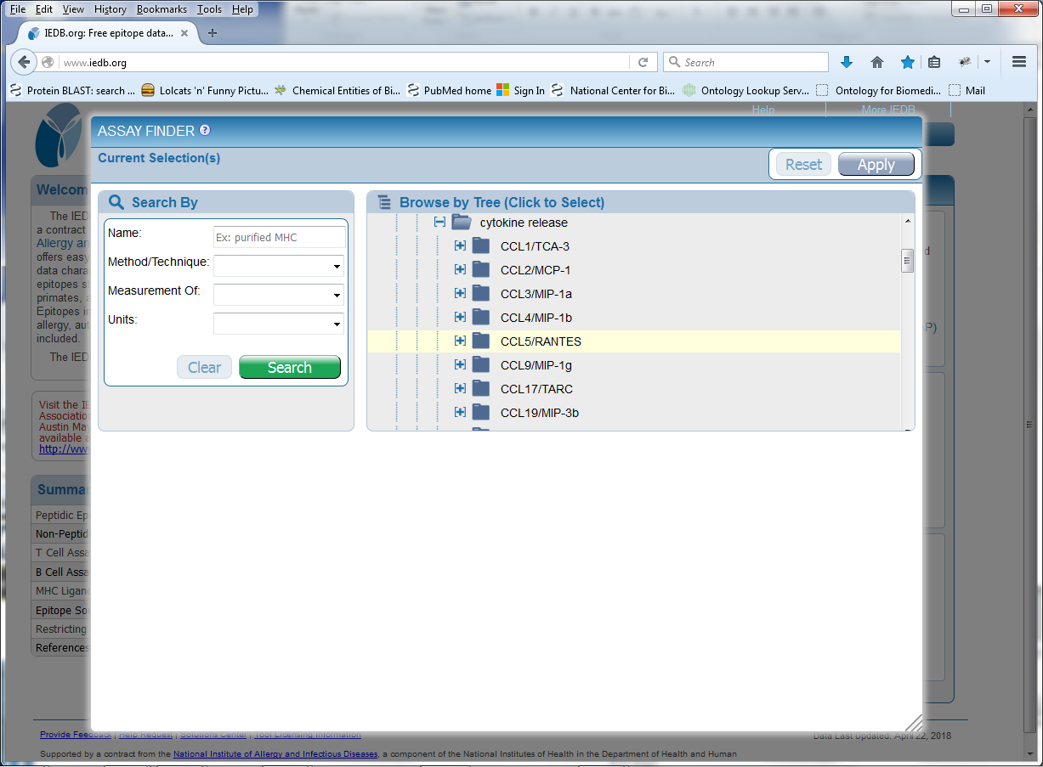
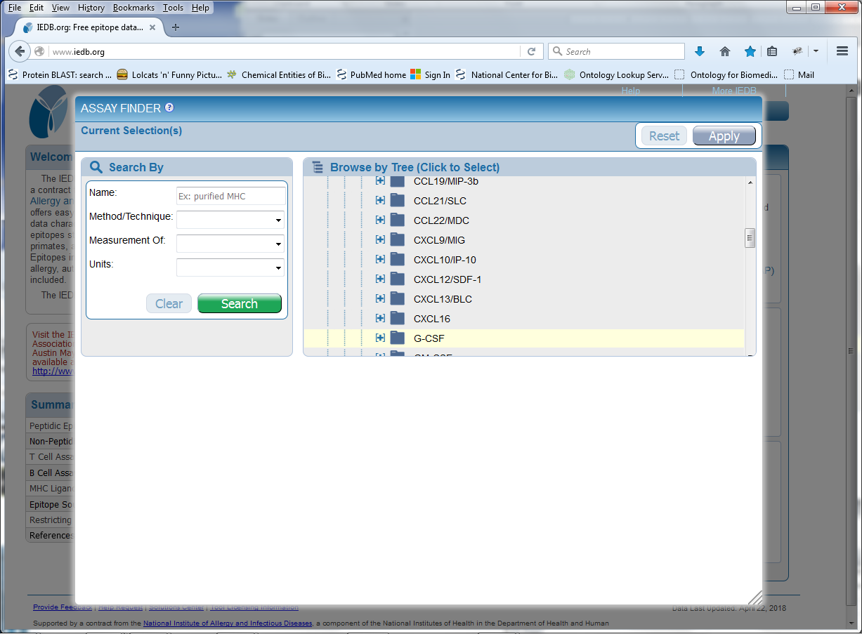
Assay Data in The IEDB

Slide 20
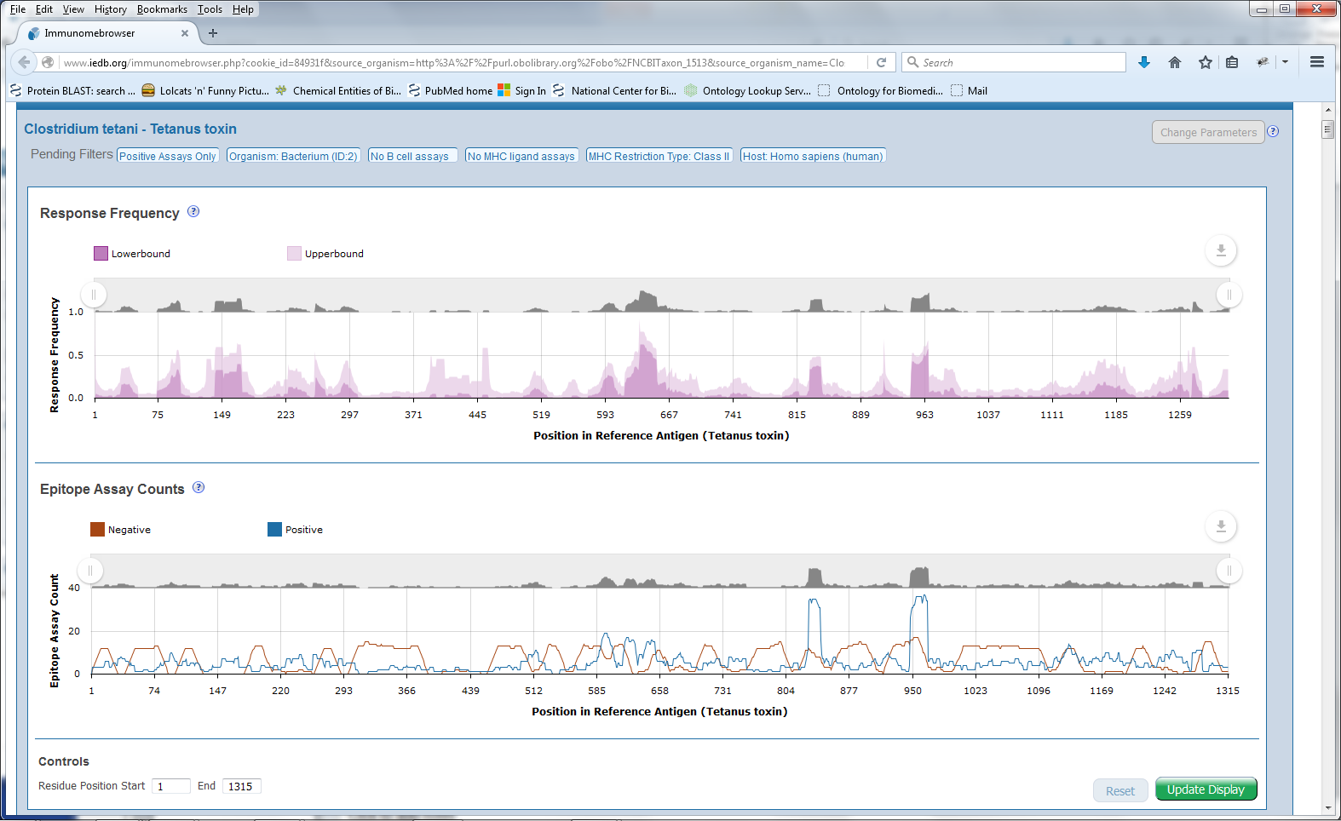
Aggregate Data in The IEDB
Clostridium tetani Tetanus toxin

Slide 21
Approach
Obtain T cell epitope recognition data from the IEDB
Quantify immunogenicity of epitopes based on frequency of recognition in human population
Determine of sequence conservation of epitopes in human proteome / human microbiome correlates with immunogenicity

Slide 22
Datasets retrieved Obtain T cell epitope recognition data from the IEDB From IEDB

Slide 23
Immunogenicity score
Immunogenicity determined by frequency of recognition
Epitope recognition in humans in inherently variable
Utilize lower bound of 95% confidence interval (cohort size issue)
Exclude antigens that are not recognized at all
Exclude assays that do not show inflammatory response

Slide 24
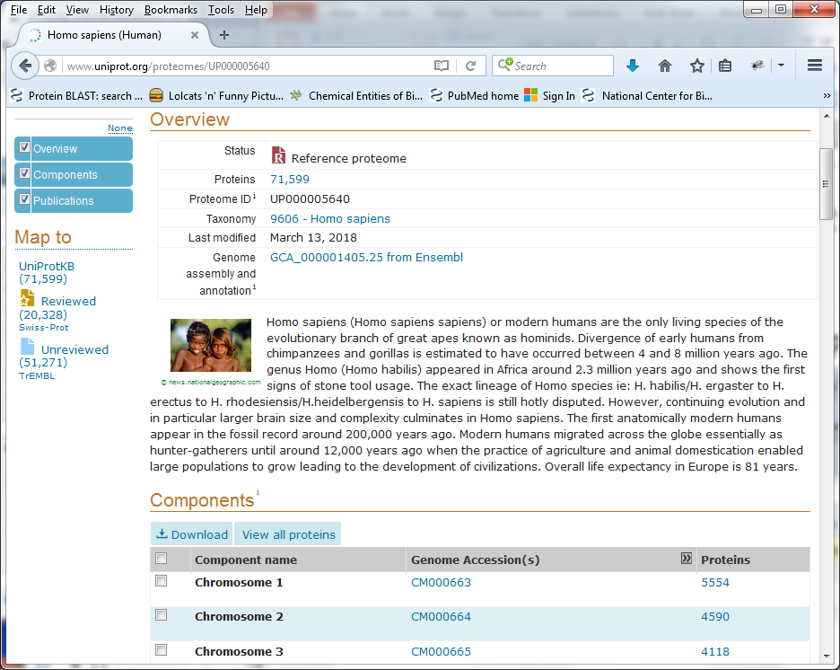
Datasets retrieved
From UniProt ‘Complete proteome’ AND organism: ‘Homo sapiens”

Slide 25
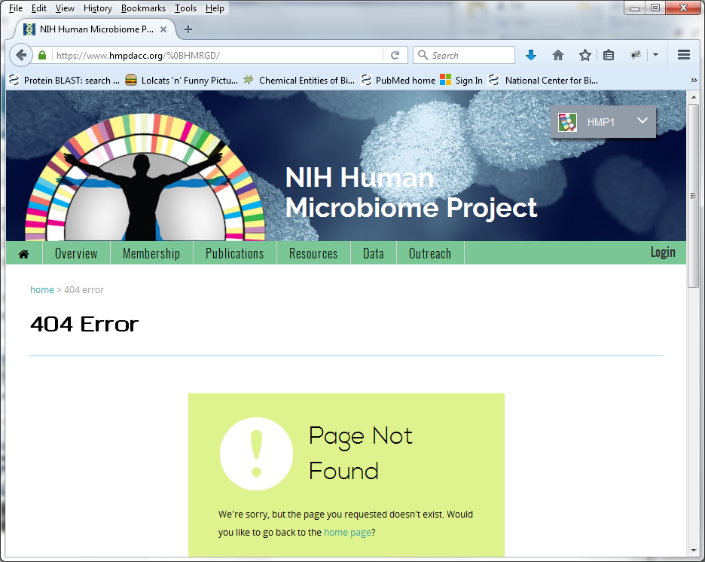
From Human Microbiome Project http://www.hmpdacc.org/HMRGD/
Datasets retrieved

Slide 26
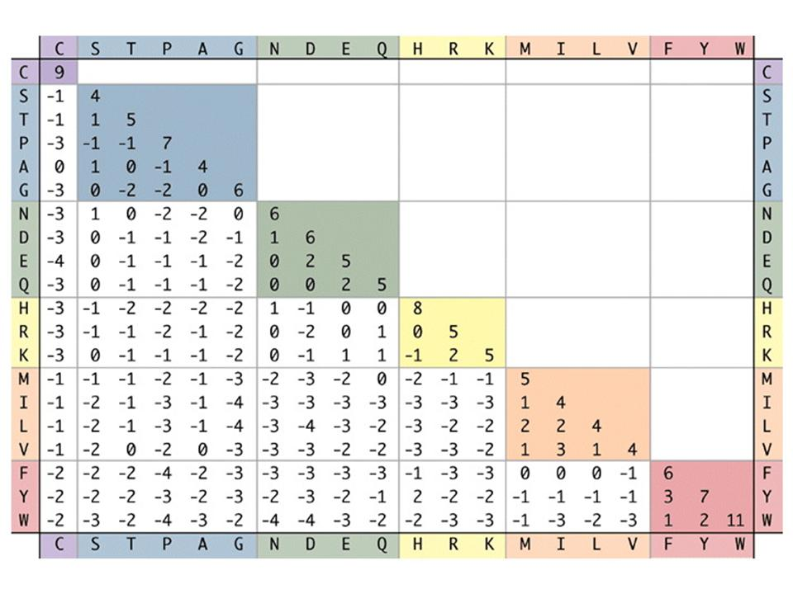
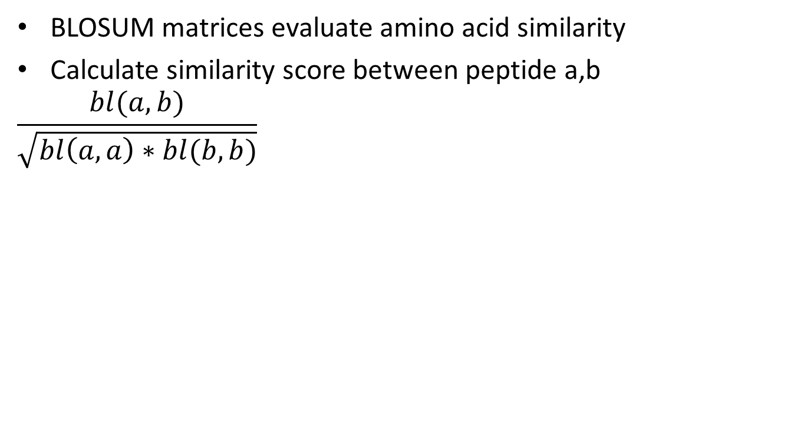
Quantifying conservation
BLOSUM matrices evaluate amino acid similarity
Calculate similarity score between peptide a,b
$$\frac{bl(a,b)}{\sqrt{bl\left(a,a\right)∗bl(b,b)}}$$
BLOSUM MATRIX: Evaluates how similar two aligned sequences are based on pairwise residue comparisons
Normalized BLOSUM SCORE= BLOSUM matrix score for the aligned sequences a and b divided by the square root of the product of the BLOSUM matrix score of each peptide aligned with themselves
→ Two identical peptides get a Normalized BLOSUM SCORE of 1.0.

Slide 27
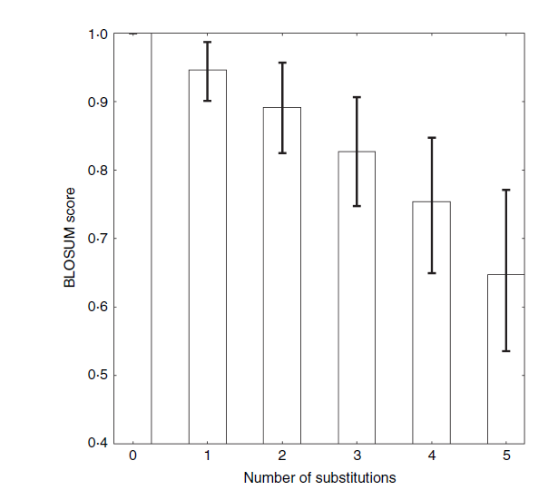
Relationship between substitutions
and blosum score
Twenty thousand peptides from UniProt compared to human gut microbiome

Slide 28
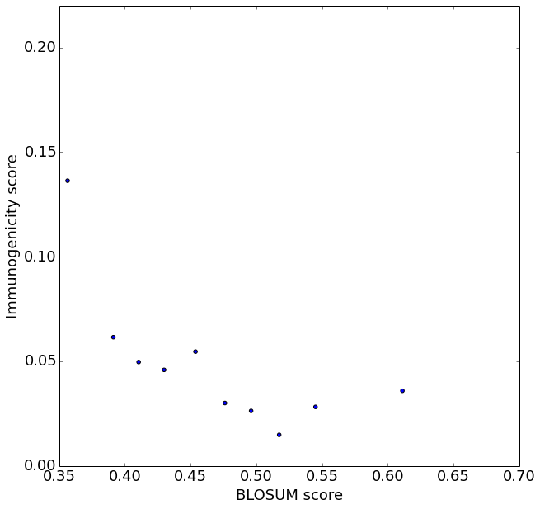
Conservation in human proteome is associated with reduced immunogenicity
Lower blosum score = less conserved

Slide 29
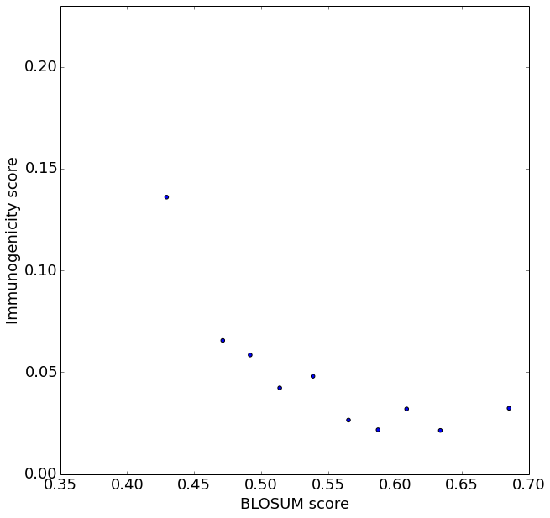
Conservation in human microbiome is associated with reduced immunogenicity
Lower blosum score = less conserved

Slide 30
Summary IEDB analysis
Peptide conservation in human microbiome and proteome impacts T cell recognition
Microbiomes at different body sites may have different impact on T cell tolerization (gut > airway)?
→ Test these hypotheses: Synthesize peptide pools from cockroach antigens with differential conservation and test for T cell recognition in IFNg ELISPOT

Slide 31
Cockroach peptide conservation
Strong epitopes
Weak epitopes
Airways Microbiome
Non-epitopes
Strong epitopes
Gut
Microbiome
Weak epitopes
Non-epitopes
Conservation (BLOSUM score)

Slide 32


Conclusions
Most conserved peptides are weakest epitopes
Anne Bresciani
Technical University of Denmark
La Jolla Institute
T-cell recognition is shaped by epitope sequence conservation in the host proteome and microbiome.
Bresciani A, Paul S, Schommer N, Dillon MB, Bancroft T, Greenbaum J, Sette A, Nielsen M, Peters B.
Immunology. 2016 May;148(1):34-9.

Slide 33
Continued comparisons across many species
15 allergens, 18 different virus families, 4 bacterial families, 4 autoimmune and inflammatory antigens

Slide 34
Positive or negative influence of conservation to microbiome as a function of epitope source

Slide 35

Thanks

Slide 36

Thanks

